Slide 1
CSL & LBA

Slide 2
Context-Sensitive Languages
A context-sensitive language is defined by a set of rewriting rules (called a grammar) involving symbols from a given finite set of symbols.
These rules take a symbol from one distinct set, the variables, and replace it with one or more symbols from another set, the terminal symbols.
The application of these rules depends on the symbols preceding and following the variable symbol, hence they are called context-sensitive.

Slide 3
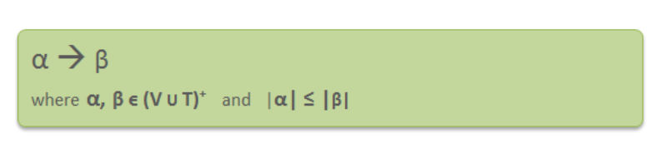
Context-Sensitive Grammar
A Context-sensitive grammar is an Unrestricted grammar in which all the
productions are of form –Where α and β are strings of non-terminals and
terminals.
Context-sensitive grammars are more powerful than context-free grammars
because there are some languages that can be described by CSG but not by
context-free grammars and CSL are less powerful than Unrestricted grammar.

Slide 4
Consider the following CSG. S → abc/aAbc Ab → bA Ac → Bbcc bB → Bb aB → aa/aaA
language generated by this grammar
S → aAbc → abAc → abBbcc → aBbbcc → aaAbbcc → aabAbcc → aabbAcc → aabbBbccc → aabBbbccc → aaBbbbccc → aaabbbccc The language generated by this grammar is {a^{n}b^{n}c^{n} | n≥1}.

Slide 5
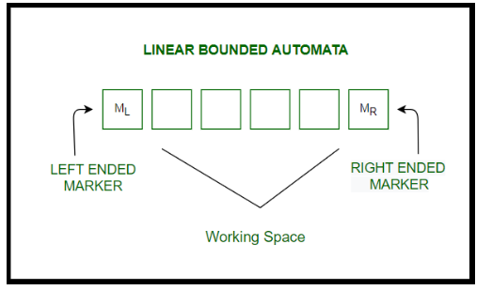
A Linear Bounded Automaton (LBA) is similar to Turing Machine with
some properties
Turing Machine with Non-deterministic logic,
Turing Machine with Multi-track, and
Turing Machine with a bounded finite length of the tape.

Slide 6
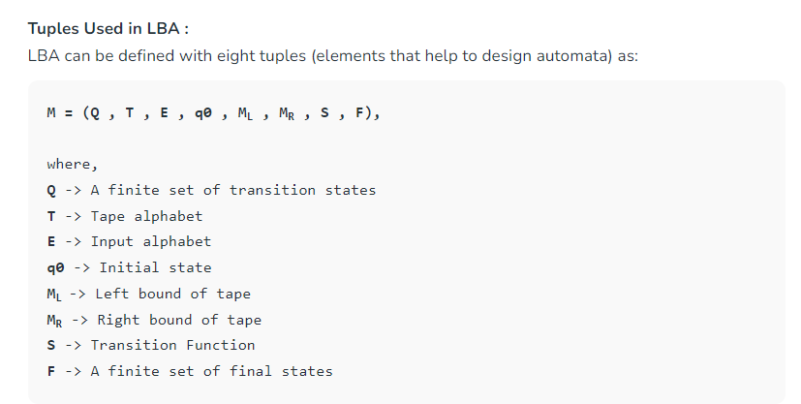

Slide 7
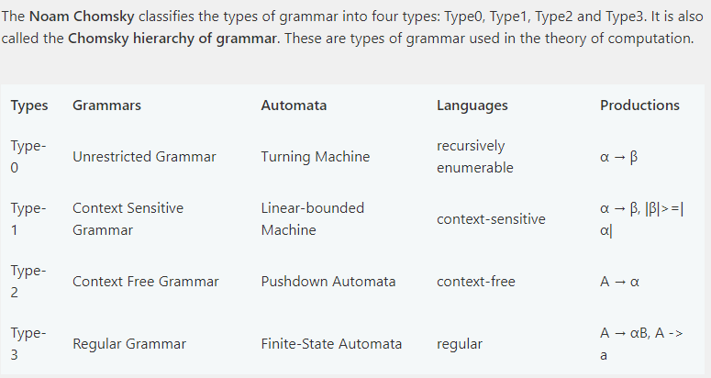

Slide 8
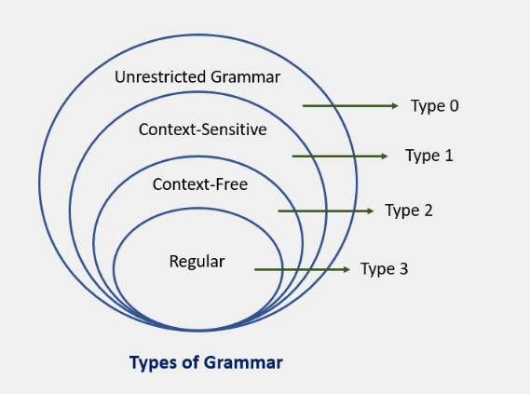

Slide 9
Problems Computers Can’t Solve
An algorithm can only resolve a problem if it generates the accurate output for any potential input.
Turing’s evidence indicates that not all problems can be addressed this way, alluding to the existence of uncomputable problems and the restrictions of algorithms.
This implies that there are certain issues that cannot be solved purely through algorithmic approaches, no matter how sophisticated or advanced they may be.
As a result, researchers and computer scientists must explore alternative methods, combining human intuition and creativity with computational power, to tackle these complex and unquantifiable challenges.

Slide 10
Recursive Enumerable (RE) or Type -0 Language
RE languages or type-0 languages are generated by type-0 grammars.
An RE language can be accepted or recognized by Turing machine which means it will enter into final state for the strings of language and may or may not enter into rejecting state for the strings which are not part of the language.
It means TM can loop forever for the strings which are not a part of the language. RE languages are also called as Turing recognizable languages.

Slide 11
Recursive Language (REC)
A recursive language (subset of RE) can be decided by Turing machine which means it will enter into final state for the strings of language and rejecting state for the strings which are not part of the language.
e.g.; L= {a^{n}b^{n}c^{n}|n>=1} is recursive because we can construct a turing machine which will move to final state if the string is of the form a^{n}b^{n}c^{n} else move to non-final state.
So the TM will always halt in this case. REC languages are also called as Turing decidable languages.

Slide 12
Closure Properties of Recursive Languages
Union: If L1 and If L2 are two recursive languages, their union L1?L2 will also be recursive because if TM halts for L1 and halts for L2, it will also halt for L1?L2.
Concatenation: If L1 and If L2 are two recursive languages, their concatenation L1.L2 will also be recursive. For Example:
L1= {a^{n}b^{n}c^{n}|n>=0}
L2= {d^{m}e^{m}f^{m}|m>=0}
L3= L1.L2 = {a^{n}b^{n}c^{n}d^{m} e^{m}f^{m}|m>=0 and n>=0} is also recursive.
L1 says n no. of a’s followed by n no. of b’s followed by n no. of c’s. L2 says m no. of d’s followed by m no. of e’s followed by m no. of f’s. Their concatenation first matches no. of a’s, b’s and c’s and then matches no. of d’s, e’s and f’s. So it can be decided by TM.

Slide 13
Kleene Closure: If L1is recursive, its kleene closure L1* will also be recursive. For Example:
L1= {a^{n}b^{n}c^{n}|n>=0}
L1*= { a^{n}b^{n}c^{n}||n>=0}* is also recursive.
Intersection and complement: If L1 and If L2 are two recursive languages, their intersection L1 ? L2 will also be recursive.
For Example:
L1= {a^{n}b^{n}c^{n}dm|n>=0 and m>=0}
L2= {a^{n}b^{n}c^{n}d^{n}|n>=0 and m>=0}
L3=L1 ? L2 = { a^{n}b^{n}c^{n}d^{n} |n>=0} will be recursive.

Slide 14
L1 says n no. of a’s followed by n no. of b’s followed by n no. of c’s and then any no. of d’s. L2 says any no. of a’s followed by n no. of b’s followed by n no. of c’s followed by n no. of d’s.
Their intersection says n no. of a’s followed by n no. of b’s followed by n no. of c’s followed by n no. of d’s. So it can be decided by turing machine, hence recursive.
Similarly, complement of recursive language L1 which is ?*-L1, will also be recursive.
Note: As opposed to REC languages, RE languages are not closed under complementation which means complement of RE language need not be RE.

Slide 15
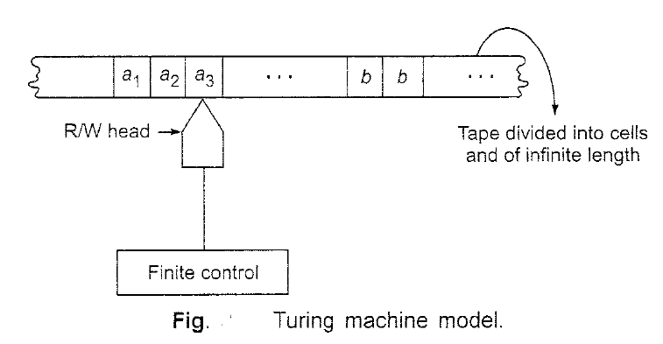
TURING MACHINE MODEL
The Turing machine can be thought of as finite control connected to a R/W (read/write) head. It has one tape which is divided into a number of cells.

Slide 16
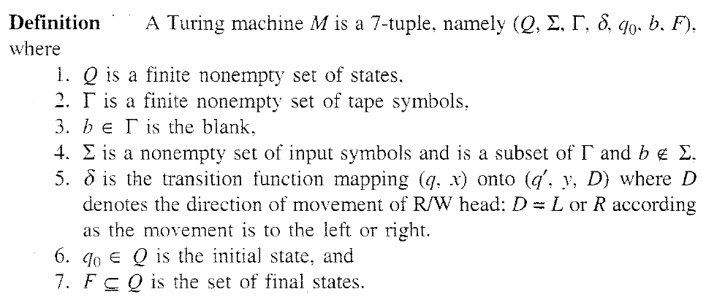
a new symbol to be written on the tape in the cell under the head,
a motion of the R/W head along the tape: either the head moves one cell left (L). or one cell right (R),
the next state of the automaton, and whether to halt or not.

Slide 17
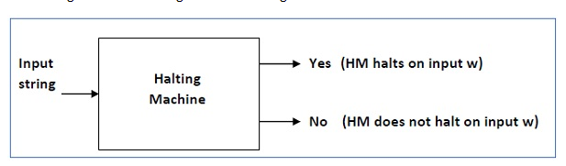
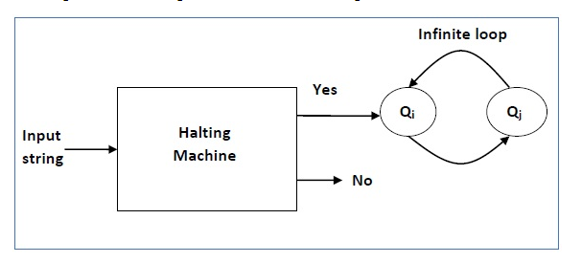
Halting machine that produces a ‘yes’ or ‘no’ in a finite amount of time. If the halting machine finishes in a finite amount of time, the output comes as ‘yes’, otherwise as ‘no’
Inverted halting machine (HM)’ as −
If H returns YES, then loop forever.
If H returns NO, then halt.

Slide 18
 | Turing Machine | Universal Turing Machine
1. | It is a mathematical model of computation it manipulates symbols on the tape according to the rules defined | Universal Turing Machine is like a single Turing Machine that has a solution to all problem that is computable
2. | A program can be compared to a Turing Machine | Programmable Turing Machine is called Universal Turing Machine
3. | Turing machine’s temporary storage is tape. The infinite cells of the Turing machine can contain input symbols and blanks. | Universal Turing Machine contains Turing Machine description as input along with an input string, runs the Turing Machine on the input and returns the result.
4. | Turing machines help us understand the fundamental limitations of mechanical computation power | Although developed for theoretical reasons, it helped in the development of stored program computers
5. | A Turing machine is a formal model of a computer with a fixed program | Universal Turing Machine provides a solution to problems that are computable
6. | It does not minimize the space complexity | It minimizes space complexity
7, | Transition function which Turing Machine performs is defined as: δ X T -> Q X T X {L,R}, where δ is the transition function | The transition function is Q × T → Q × T × {L, R}, where Q is a finite set of states, T is the tape of the alphabet
8. | In the set theory point of view, all Turing machines form a set of the all the device that accepts type 0 grammar | Universal Turing Machine is a subset of all the Turing Machines

Slide 19
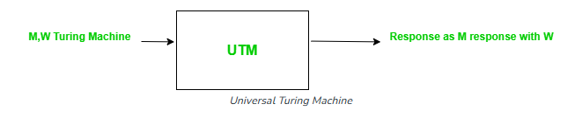
A Universal Turing Machine (UTM) is a Turing Machine that can simulate any other Turing Machine. It can be thought of as a “programmable” Turing Machine that can read the description of another Turing Machine and simulate its behavior on a given input . The UTM is a powerful concept because it shows that any algorithmic problem that can be solved by a Turing Machine can be solved by a single UTM.
A Universal Turing Machine is a Turing Machine which when supplied with an appropriate description of a Turing Machine M and an input string w, can simulate the computation of w.

Slide 20
The applications of UTM are vast and varied. Some of the most notable ones are:
Computability Theory: The UTM is a fundamental concept in computability theory, which is the study of what can and cannot be computed by machines. The UTM shows that there is a universal machine that can compute anything that can be computed by any other machine .
Programming Languages: The UTM is used to prove theorems about programming languages and their compilers. For example, the Church-Turing thesis states that any function that can be computed by an algorithm can be computed by a Turing Machine or a UTM .
Artificial Intelligence: The UTM is used in the design and analysis of algorithms for artificial intelligence. For example, the UTM can be used to simulate the behavior of a neural network or a genetic algorithm .
Cryptography: The UTM is used in the design and analysis of cryptographic algorithms. For example, the UTM can be used to simulate the behavior of a cipher or a hash function .

Slide 21
Programming Techniques for Turing Machines
The following programming techniques can be used to make the behavior of a TM clearer but none of these techniques adds any additional computational power to a basic TM.
Storage in the state
We can make a state a tuple with a fixed number of fixed-size components.
Components of the tuple can hold a fixed amount of data to simplify the behavior of a TM program.
Multiple tracks
We can make each symbol of the input alphabet a tuple with a fixed number of fixed-size components.
Components of the tuple can hold marks and other information to indicate that an input tape square has been previously visited or has been given some fixed value.
Sets of states as subroutines
We can group states into "subroutines" where a subroutine has its own start state and another state which can serve as a "return" state.

Slide 22
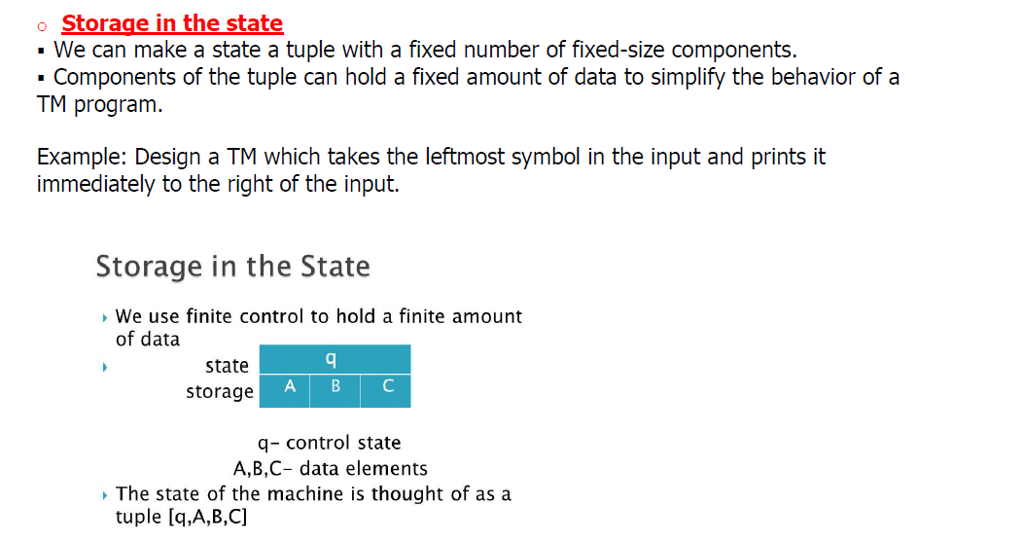
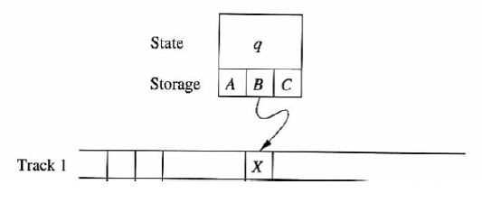

Slide 23
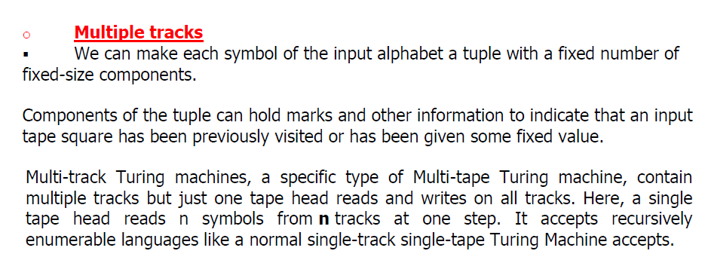

Slide 24
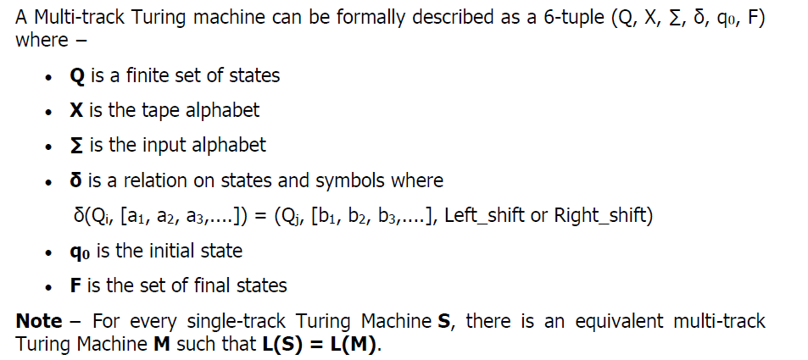

Slide 25
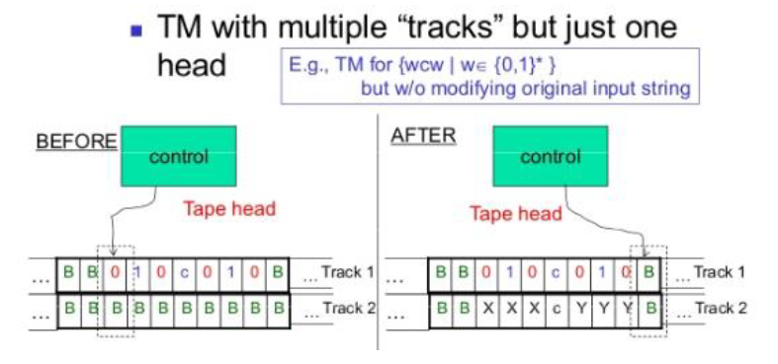

Slide 26
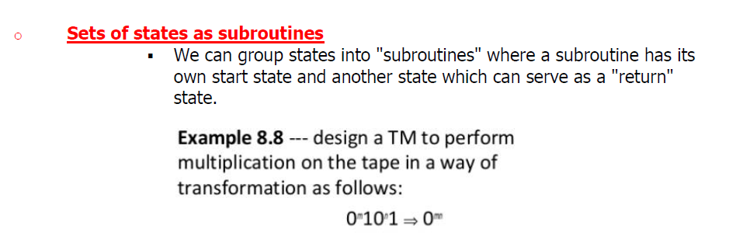

Slide 27
Extensions of basic Turing Machines
Multiple Tape TM
Two way infinite loop
Multi Head TM
Multidimensional TM
Nondeterministic TM

Slide 28
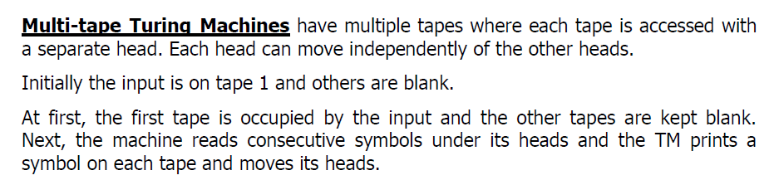
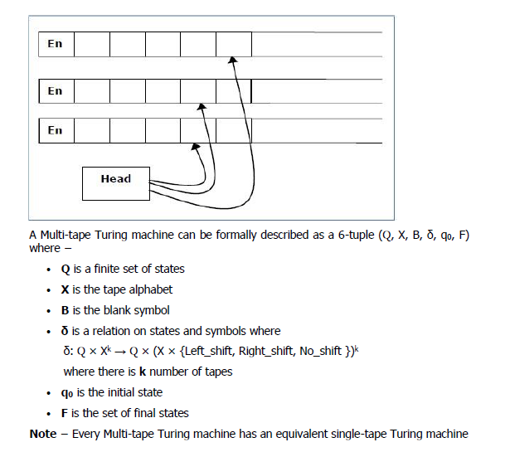

Slide 29

Two way infinite tape
Infinite tape of two-way infinite tape Turing machine is unbounded in both directions left and right.
Two-way infinite tape Turing machine can be simulated by one-way infinite Turing machine(standard Turing machine).

Slide 30
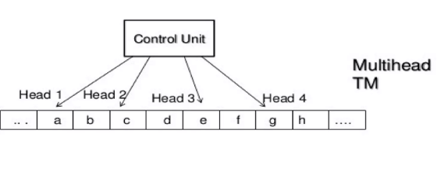
Multi head TM
A multi-head Turing machine contains two or more heads to read the symbols on the same tape.
In one step all the heads sense the scanned symbols and move or write independently.
Multi-head Turing machine can be simulated by a single head Turing machine

Slide 31
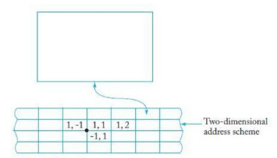
Multi dimensional TM
It has multi-dimensional tape where the head can move in any direction that is left, right, up or down.
Multi dimensional tape Turing machine can be simulated by one-dimensional Turing machine

Slide 32
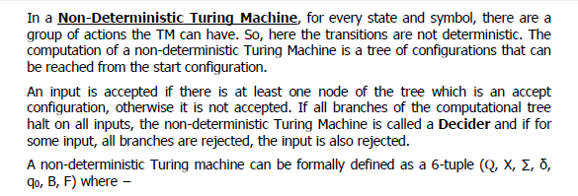
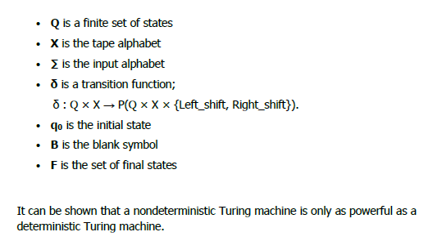

Slide 33
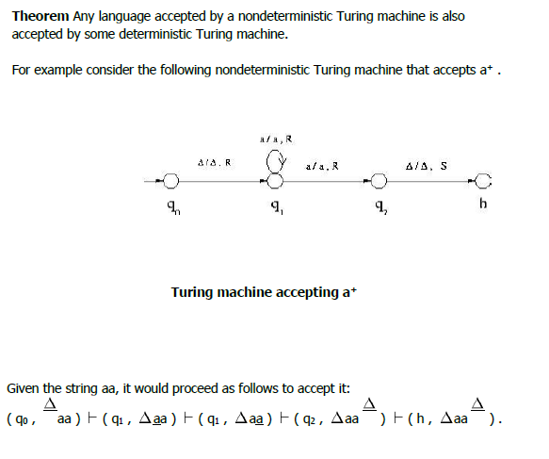

Slide 34
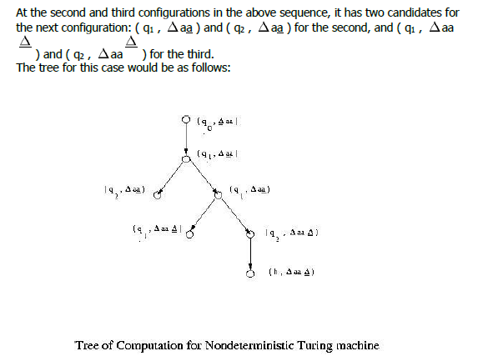

Slide 35
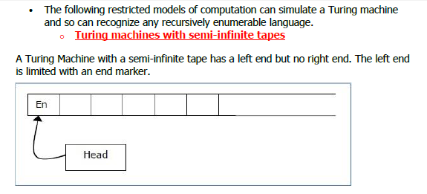
Restricted Turing Machine

Slide 36
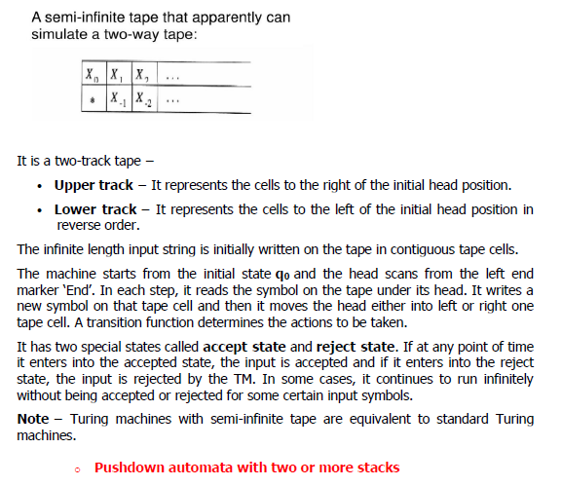
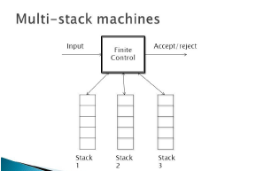

Slide 37
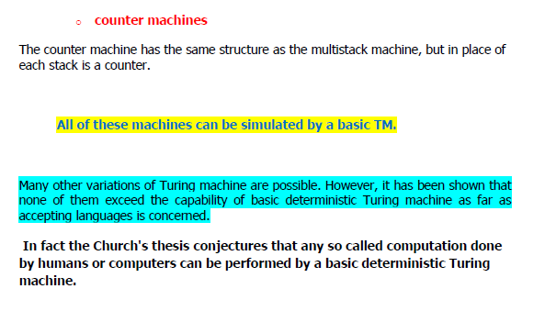

Slide 38
Turing Machine & Computers
A TM M, is the finite control with finite number of states and a finite number of transition rules.
A TM table grow infinitely long but the computers memory- main memory, disk, storage devices are finite.
Common computers have swappable storage devices, a “ZIP”disk

Slide 39
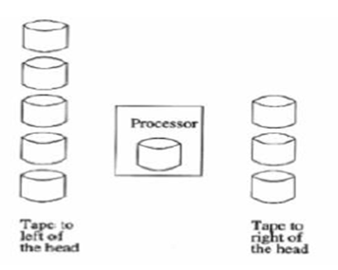
Let us assume as many disks as the computer needs is available and arrange that the disks are places in 2 stacks
One stack holds the data in cells of the TM tape that are located significantly to the left of the tape head and the other stack holds data significantly to the right of the tape head

Slide 40
If the tape head of the TM moves sufficiently far to the left that it reaches cells that are not represented by the disk currently mounted in the computer then it prints a message “SWAP LEFT”.
Then currently mounted disk is removed by a human operator and placed on the top of the left stack is mounted in the computer and computation resumes.
Similarly “SWAP RIGHT” if TM tape head reaches to right that cells are not represented by the mounted disk.

Slide 41
If either stack is empty when the computer asks that a disk from that stack be mounted, then the TM has entered an all blank region of the tape, then human operator must go to the store and buy a fresh disk to mount

Slide 42
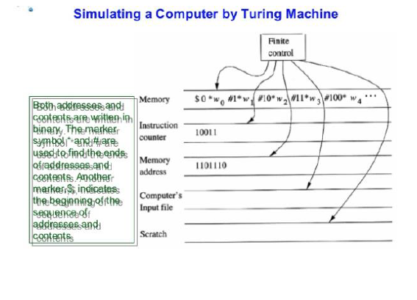

Slide 43
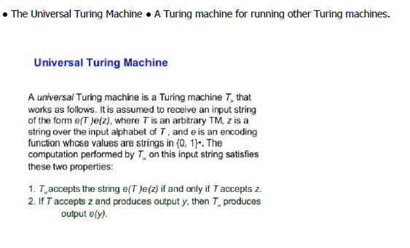
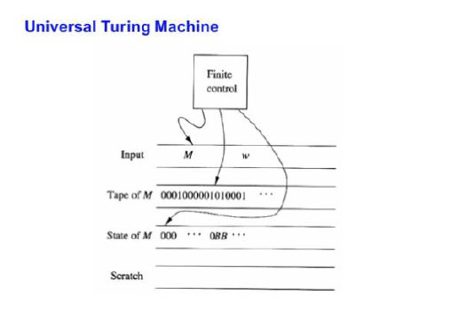

Slide 44
